Slide 1

Order Management Website For Sarode Distributors (Sponsored)
Under Guidance of
Prof. Khande Mam
Govt. Polytechnic Mumbai
By,
Yugandhar Sarode (FS19IF002)
Prathamesh Patil (FS19IF004)
Omkar Chemate (FS19IF015)
Chirag Bhandari (FS19IF020)

Slide 2
Outline:-
Introduction
Objective
Information about Website
Features
Languages and Software used
Database Setup
Facilities to the Customers
Facilities to the Admin
Flow Chart
Graphical User Interface
Future plans
Conclusion
References

Slide 3
Introduction to Website:-
Our website refers to a Wholesale Agency (Sarode Distributors) that is involved in sale of Pharmaceutical Products by ordering them online and delivering them to the Retailer.
Retailer can See the Products as per their requirement and they can do inquiry through mail or directly contact to Agency.
Admin monitors the activity of the user and check the orders

Slide 4
Objective:-
It is the user friendly website for everyone which manage sections of Pharmacy like Medicine purchasing.
It is easy for user to use and buy the medicines
A summarized list of medicines can be viewed for monitoring purpose.
User can select the medicines of their requirement.

Slide 5
Information About Website :-
The website where Agency connects neighbourhood licensed pharmacy to the agency.
Order that is received is verified by the owner of the agency.
The owner forward the verified order to a licensed pharmacy.
Variety of medicines like Ayurvedic,Allopathic medicines are available.
Physical address of the pharmacy owner need to be specify compulsory in case of any review or complaint.

Slide 6
Features:-
Login and signup
Add to cart
Update quantity or Remove item from cart
Checkout
Check previous orders
E-mail Confirmation after booking Order
Company list
Category list
Product list
Responsive website

Slide 7
Frontend (Language Used):-
HTML:- HTML (Hypertext Markup Language) is the code that is used to structure a web page and its content.
CSS:- Cascading Style Sheets (CSS) is a stylesheet language used to describe the presentation of a document written in HTML
BOOTSTRAP:- (Framework of CSS and Javascript)

Slide 8
Backend:-
PHP:- PHP is a server side scripting language. that is used to develop Static websites or Dynamic websites or Web applications. PHP stands for Hypertext Pre-processor, that earlier stood for Personal Home Pages.
MySQL:- MySQL is a relational database management system based on SQL – Structured Query Language. The most common use for mySQL however, is for the purpose of a web database.
JAVASCRIPT:- JavaScript allows you to implement dynamic features on web pages that cannot be done with only HTML and CSS

Slide 9
Software Used:-
Xampp:- XAMPP is basically local host or a local server. This local server works on your own desktop or laptop computer. The use of XAMPP is to test the clients or your website before uploading it to the remote web server. This XAMPP server software gives you a suitable environment for testing MYSQL, PHP, Apache, and Perl projects on the local computer.
Visual Studio Code:- VS Code is a Integrated Development Environment(IDE) developed by Microsoft to develop GUI console, Web applications, web apps, mobile apps, etc..

Slide 10
Chrome or any other browser:- To Run Our Website
Phpmyadmin:- phpMyAdmin is a free software tool written in PHP intended to handle the administration of MySQL over the Web. phpMyAdmin supports a wide range of operations on MySQL and MariaDB. Frequently used operations (managing databases, tables, columns, relations, indexes, users, permissions, etc) can be performed via the user interface, while you still have the ability to directly execute any SQL statement.

Slide 11
Database Setup:-
For Database we have used php MyAdmin.
In this Project,we have created a Database called "store_db".
In which,we have Admin ,cart,contact us,orders,brands, Categories, products,user_info tables.
In tables there are columns for login details of Users and Admin,total number of available products with types,total number of products sold,brand names,etc are provided.

Slide 12
Facilities to the customers:-
Easy order booking online.
User can sort medicines in companies and Categories.
User can Add or Remove the Products in Cart.
User can Update Quantity in Cart.
User can view Booked Orders.
User can Change or Recover Password.
User can give Feedback to Owner through e-mail.
E-mail Facility: User will receive an e-mail from Owner once the order is booked.

Slide 13
Facilities to the Admin:-
Admin can view the customers Details.
Admin can view Orders Booked by the Customers.
Admin can Add or Delete Products, Categories & Companies.

Slide 14
Flow charts:-
Start
1) User working
Login
Have Account
No
Registration
Yes
View Products
Book order
Stop

Slide 15
2)Admin working
Start
Admin Panel
no
Admin Login
yes
Add Data
no
Adding Data
yes
Remove Data
no
Removing Data
yes
Database
Stop

Slide 16
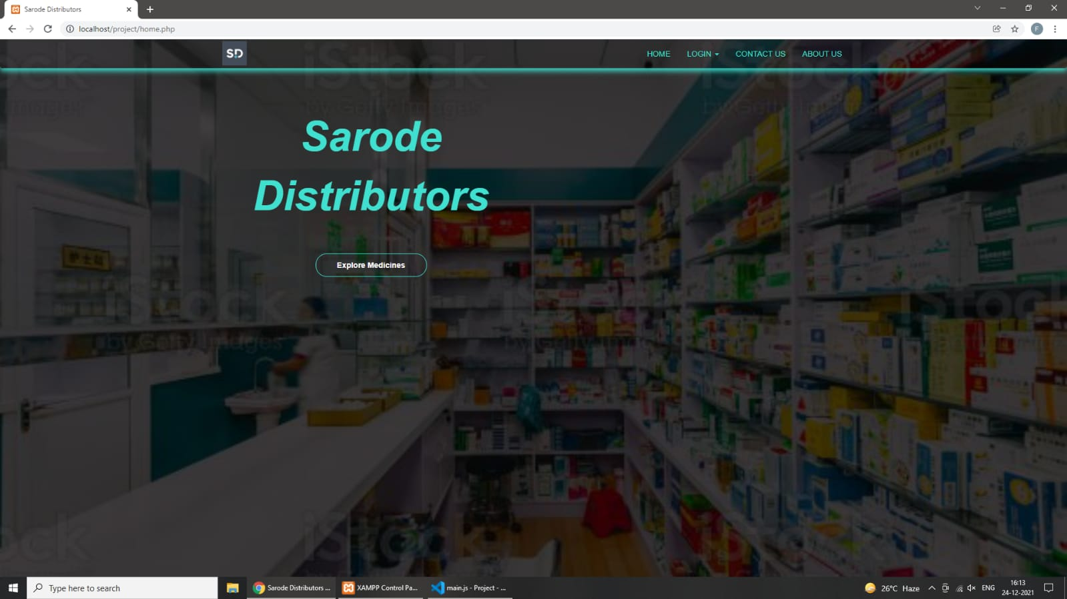
Graphical User Interface:-
Home page

Slide 17
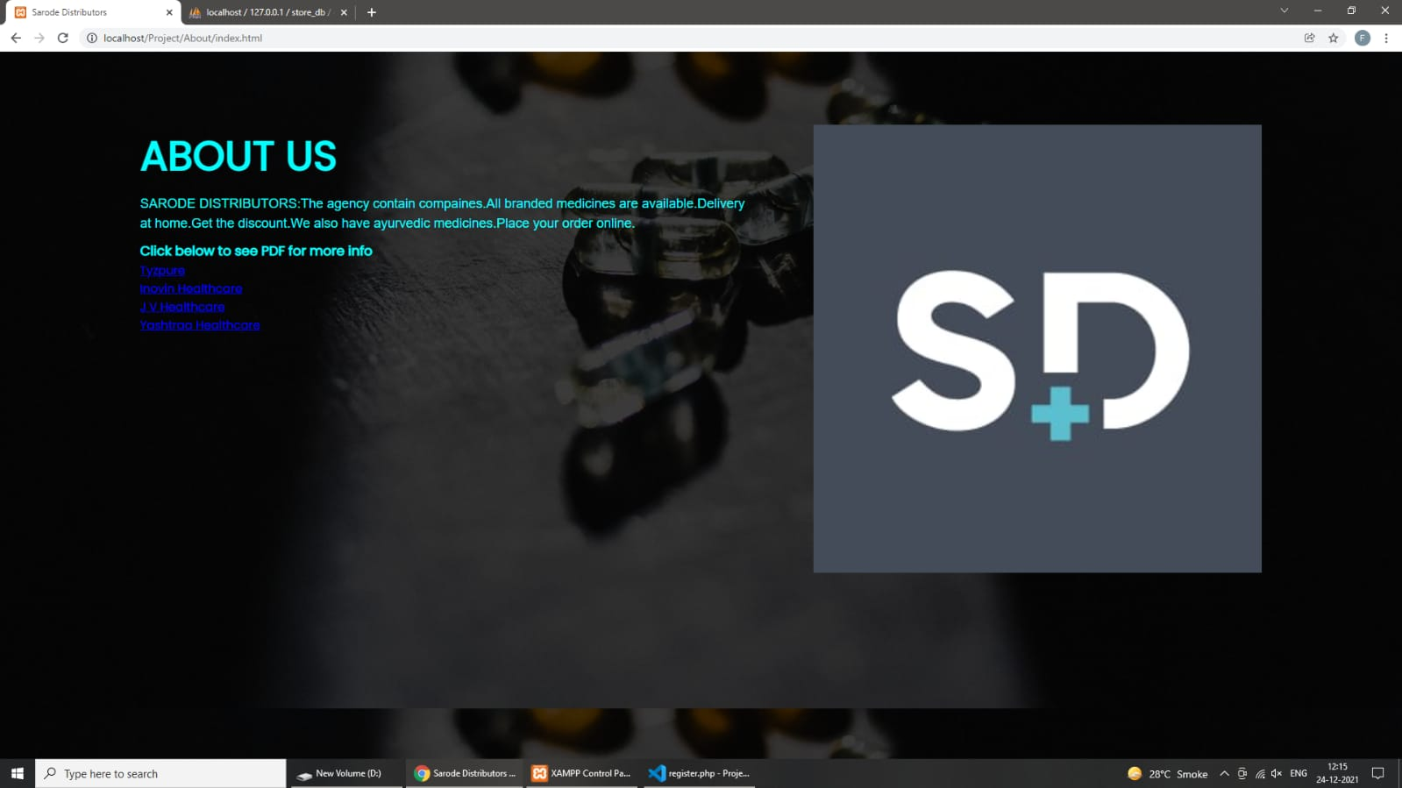
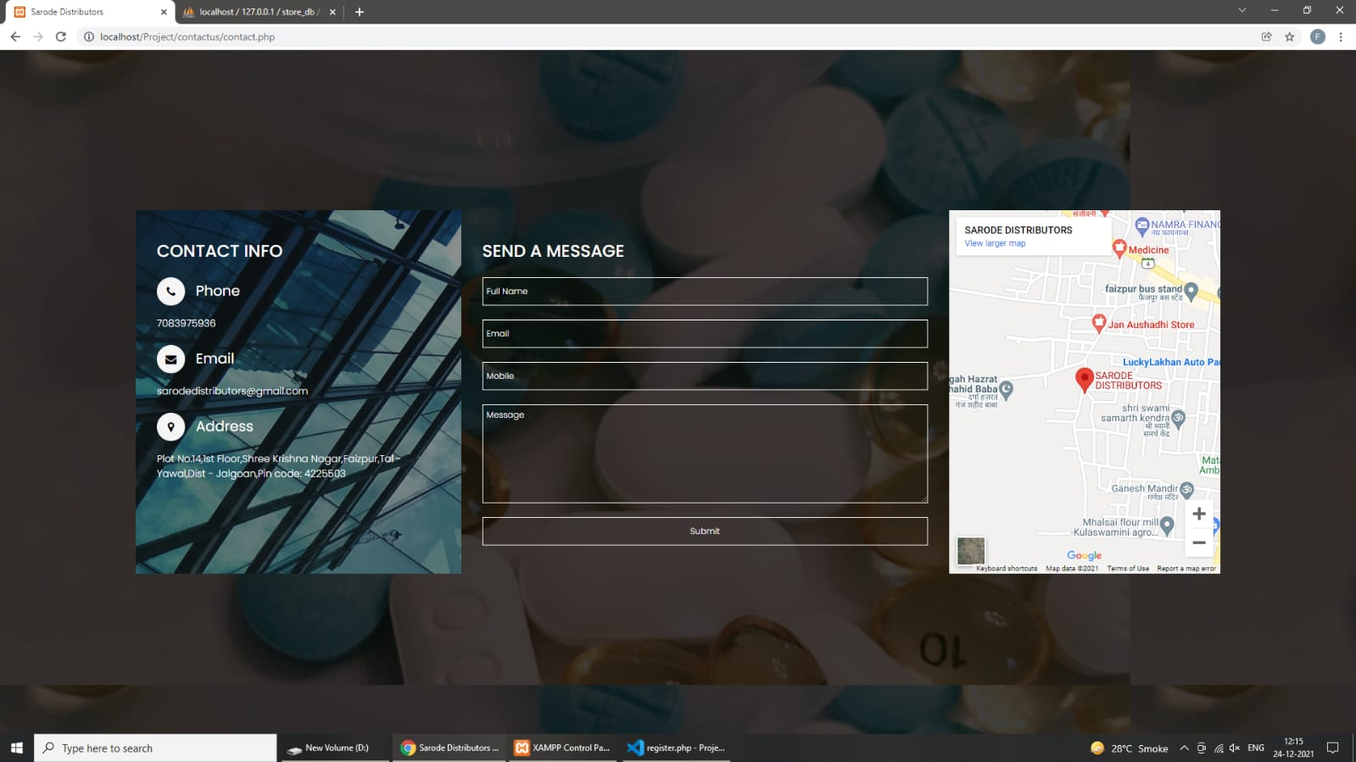
About us
Contact us

Slide 18
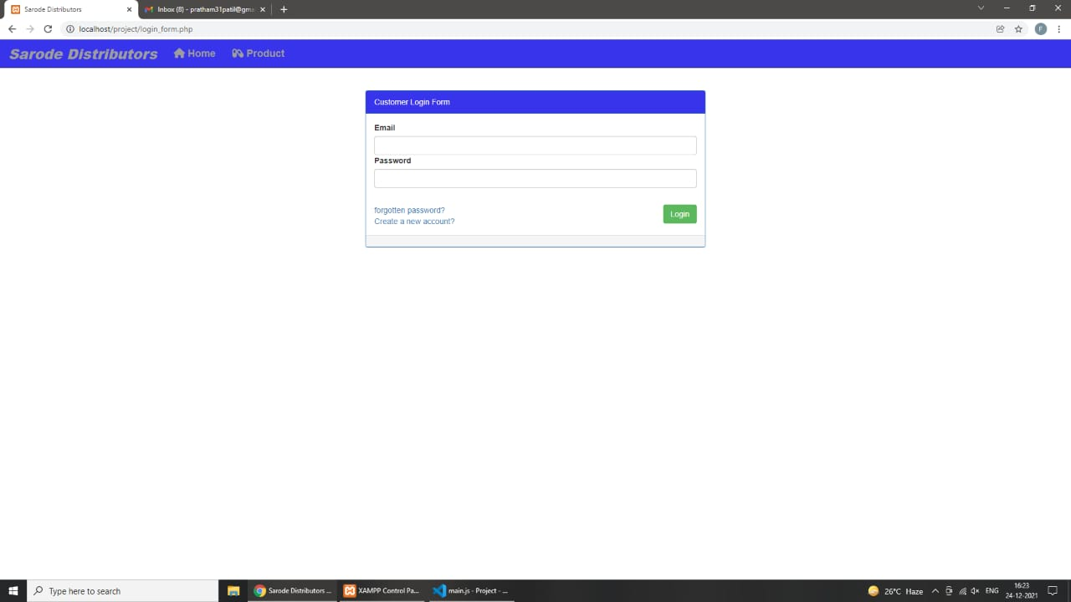
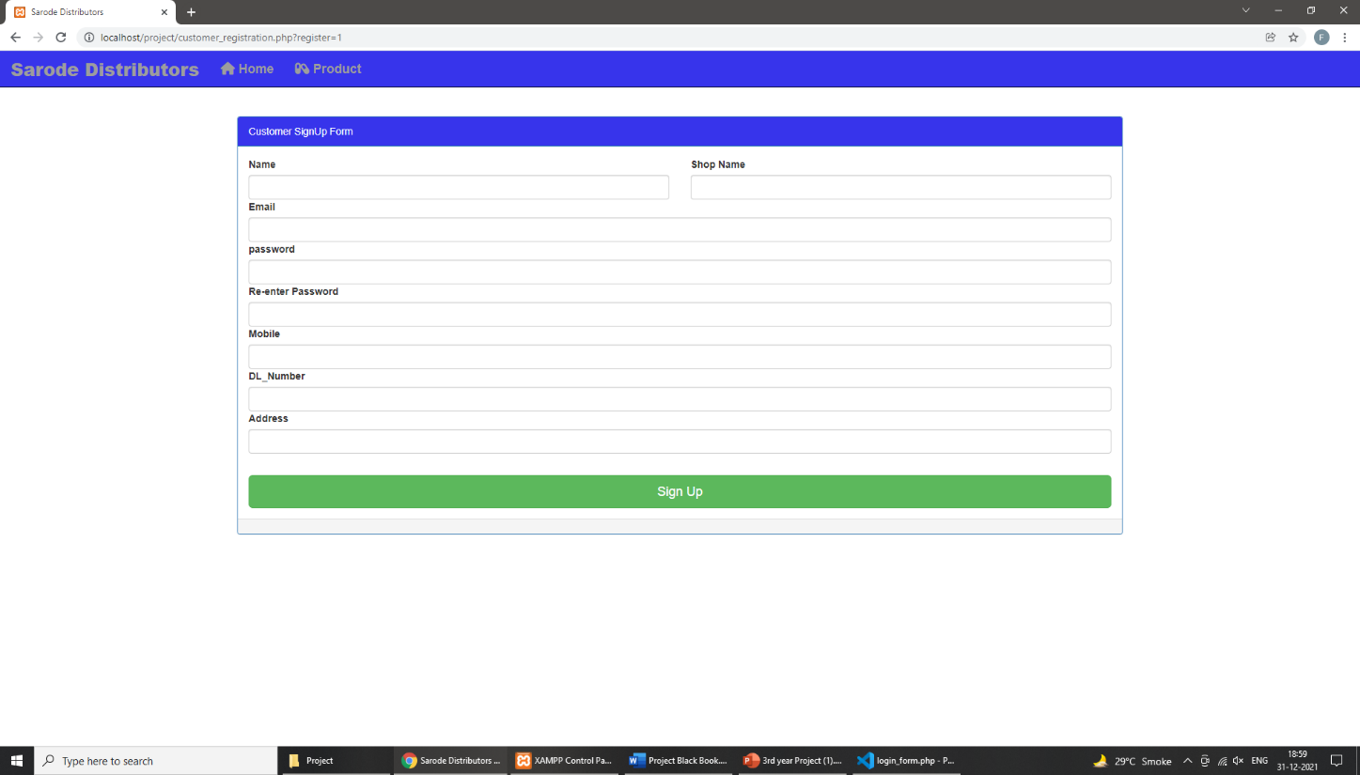
Login form
Registration form

Slide 19
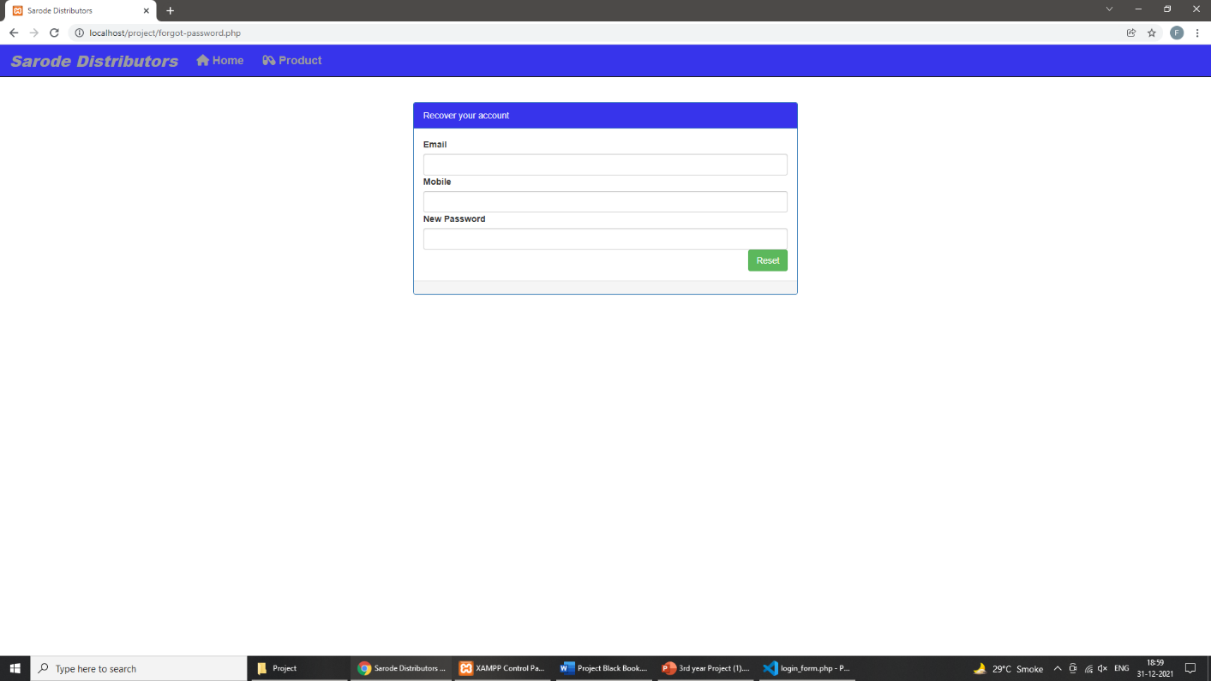
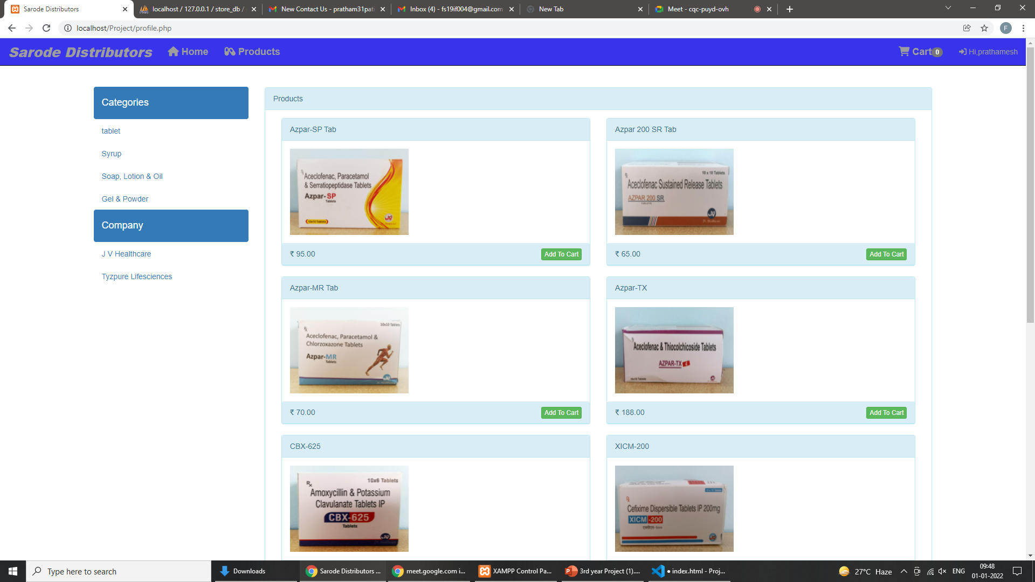
Forgot Password
Product page

Slide 20
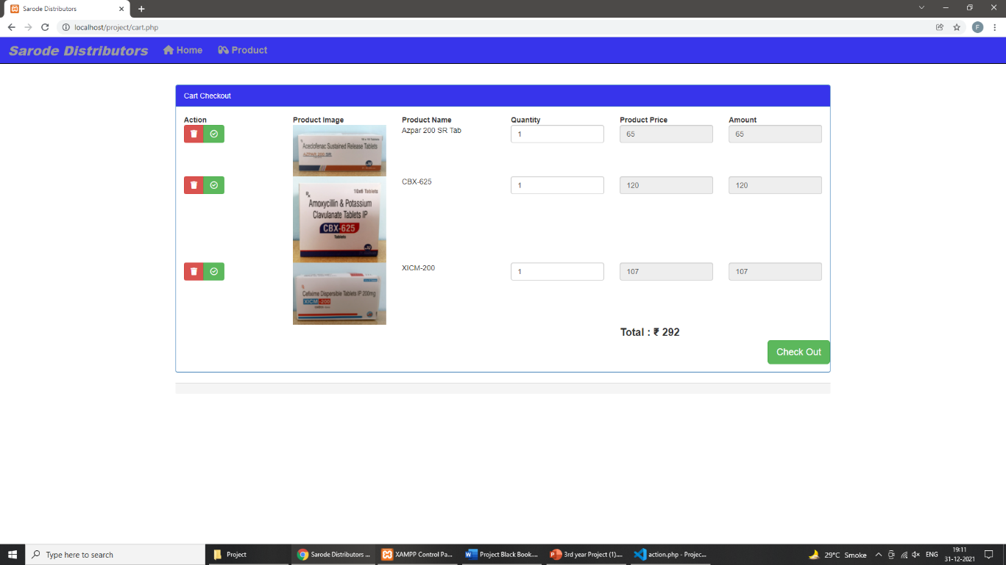
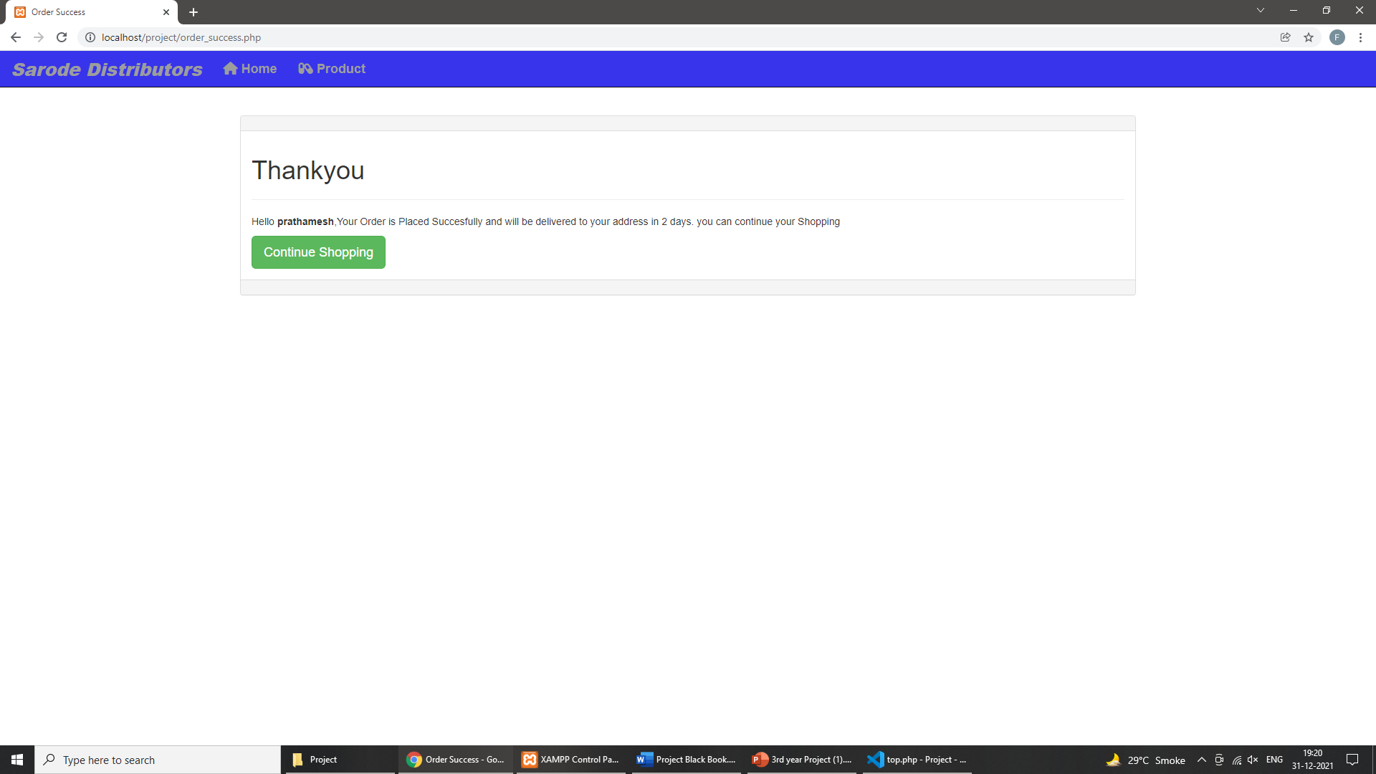
Cart page
Order confirm page

Slide 21
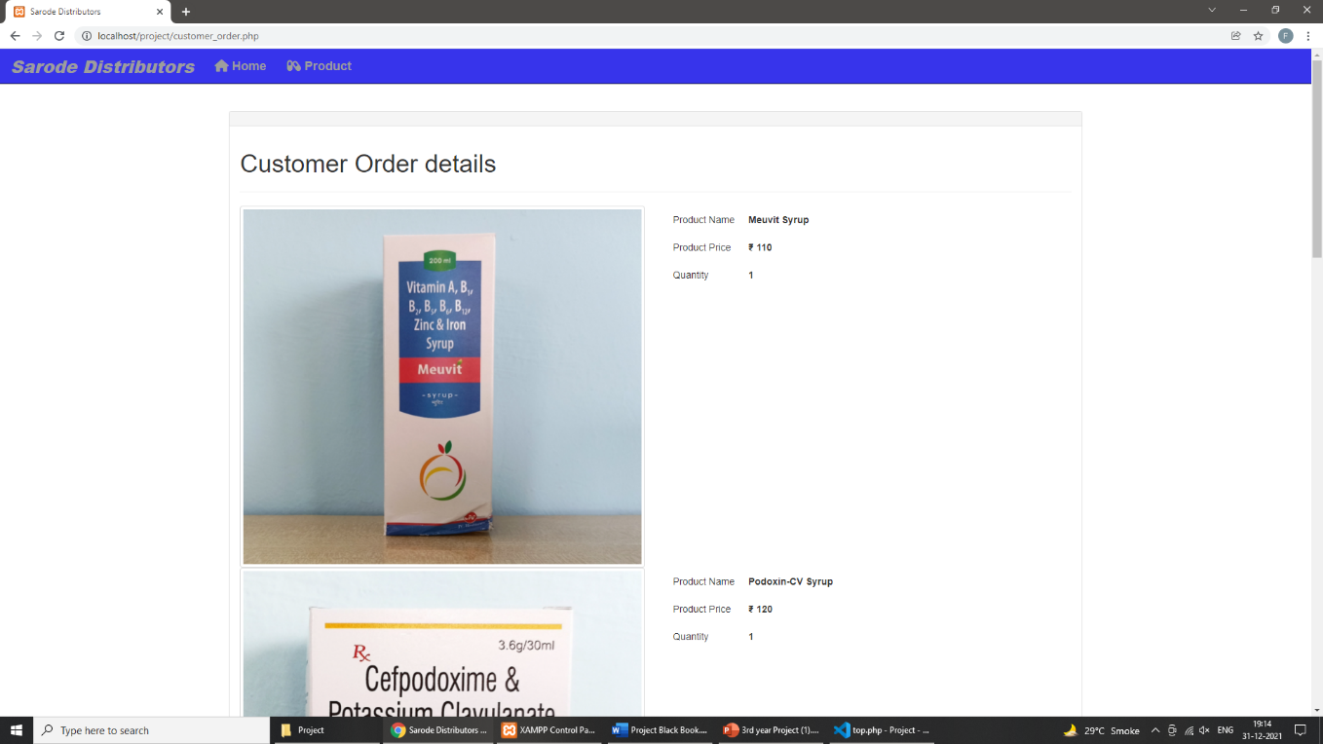
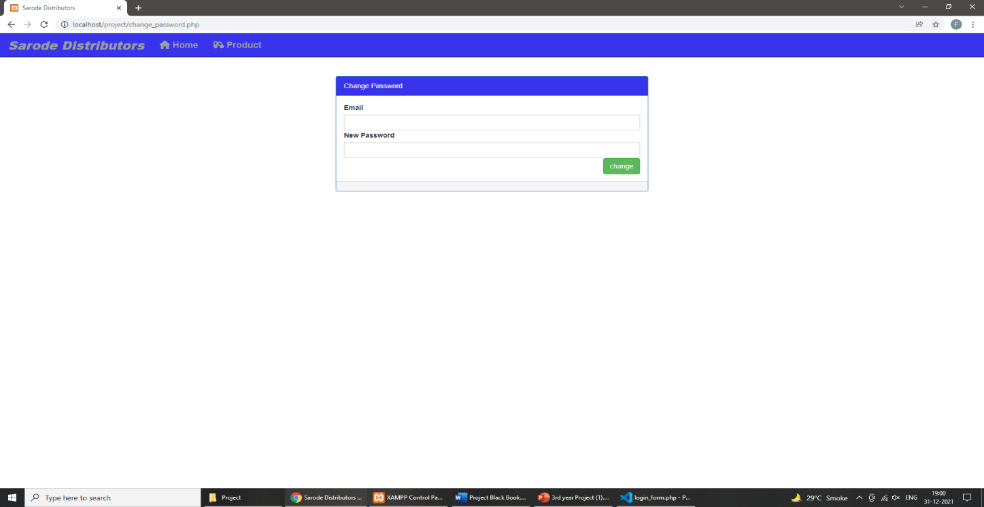
Customer order details
Change password

Slide 22
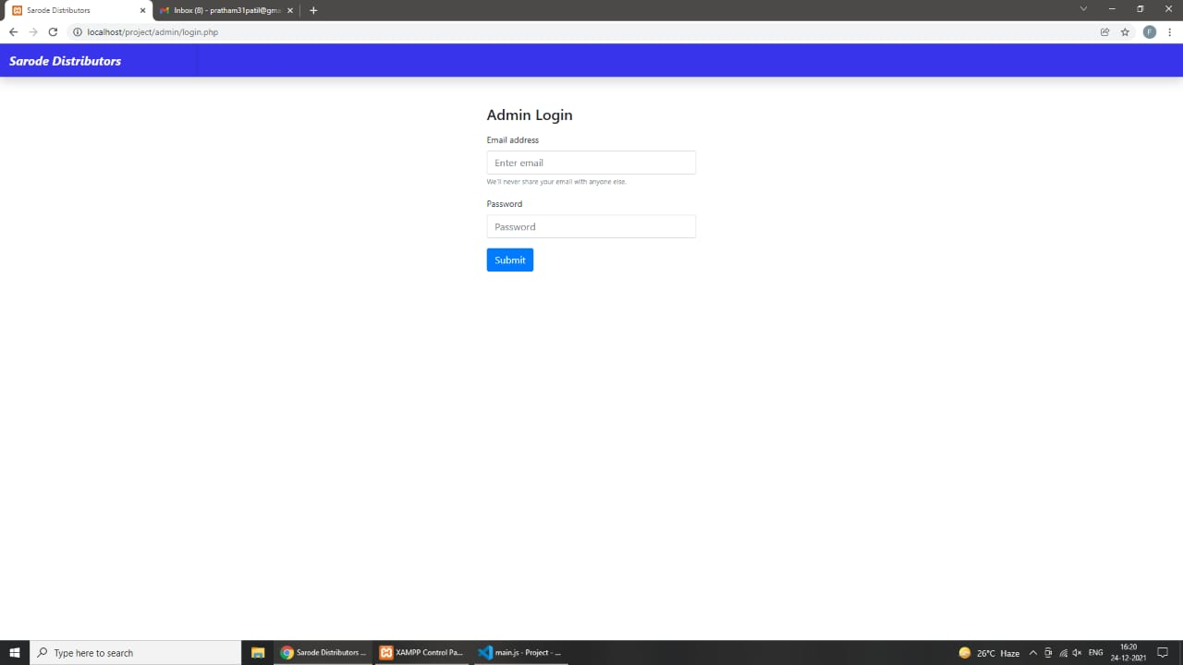
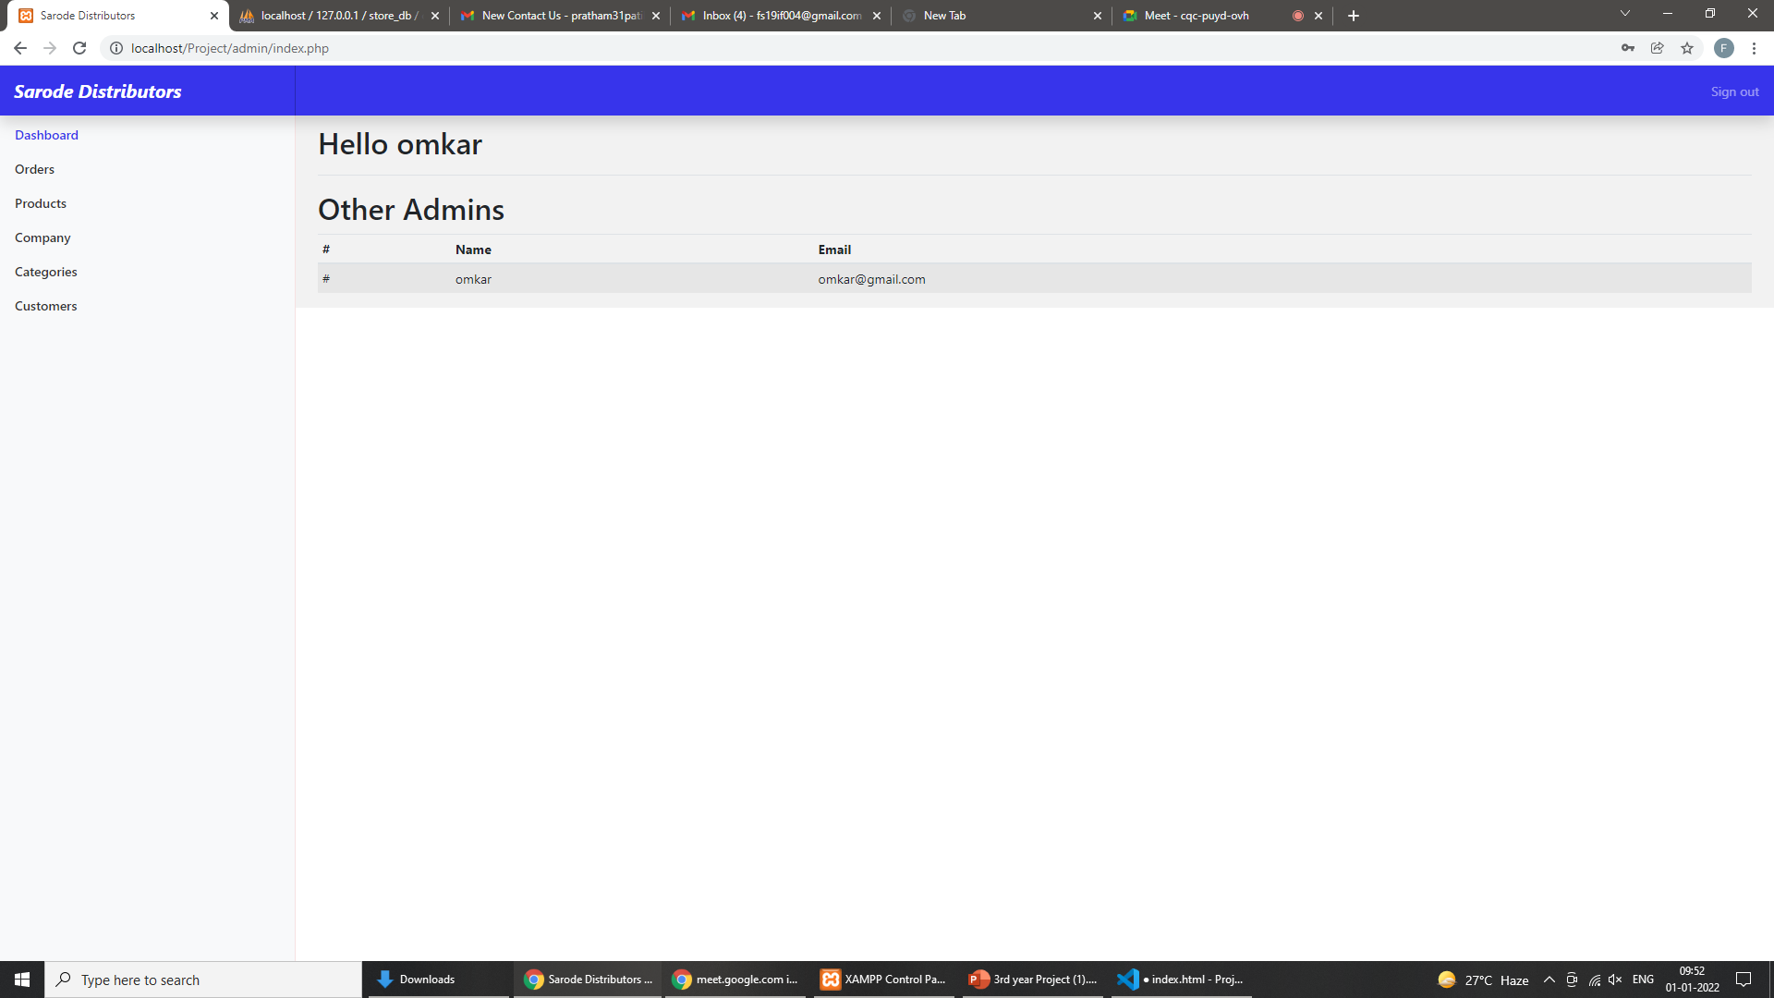
Admin login
Admin Dashboard

Slide 23
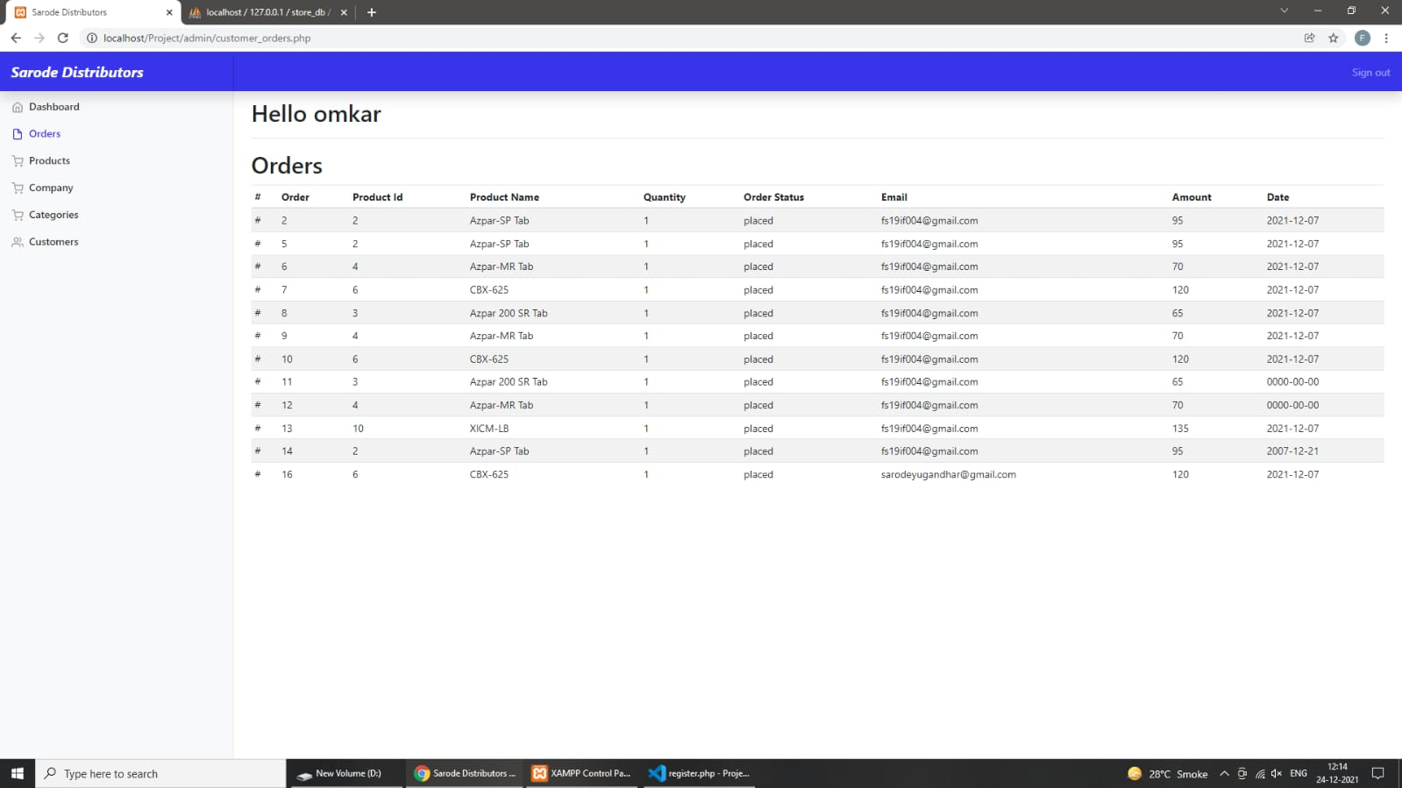
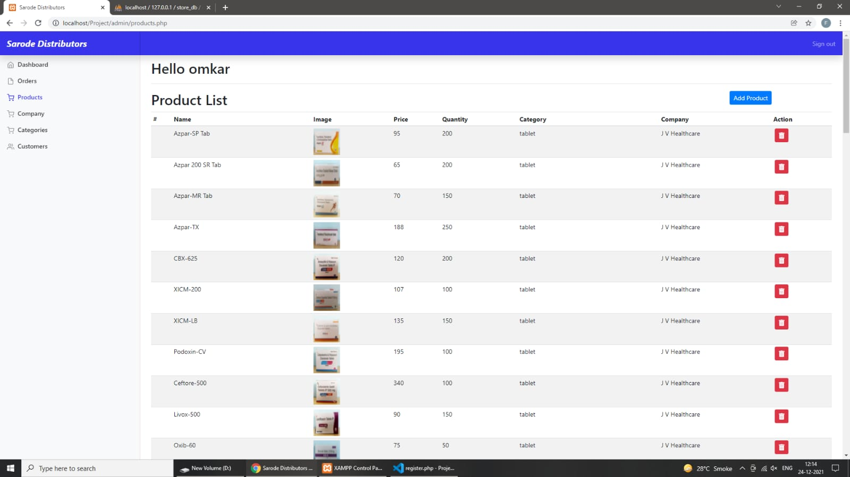
Customer Order details
Product Details

Slide 24
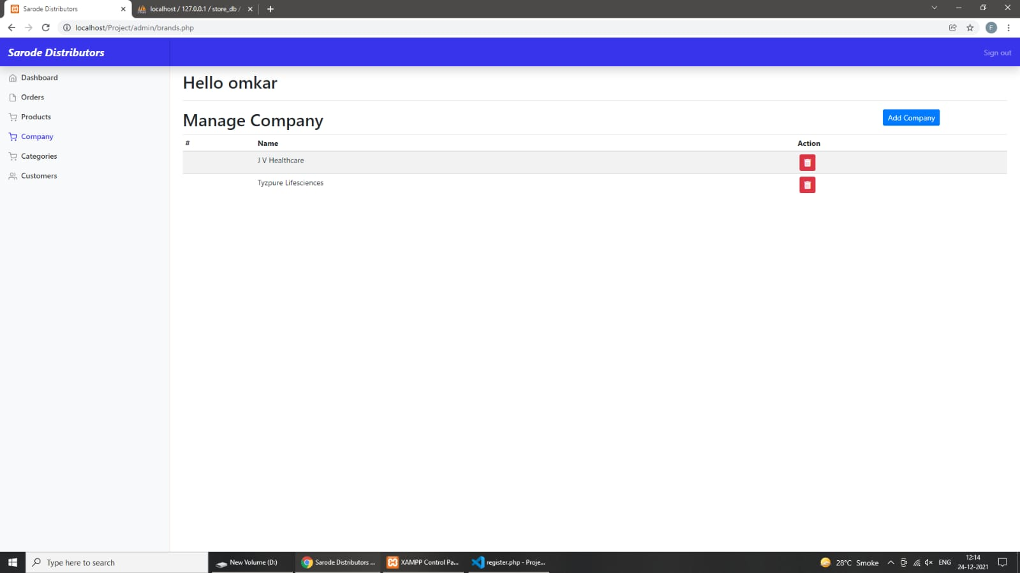
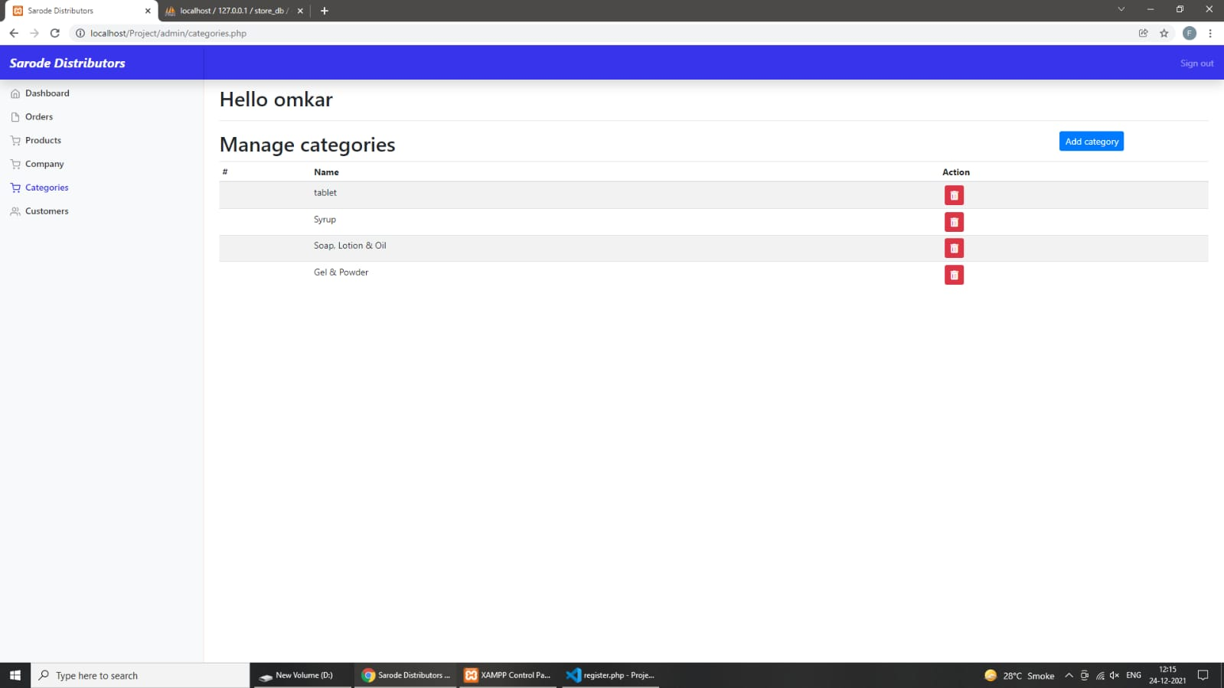
Companys Details
Catagories Details

Slide 25
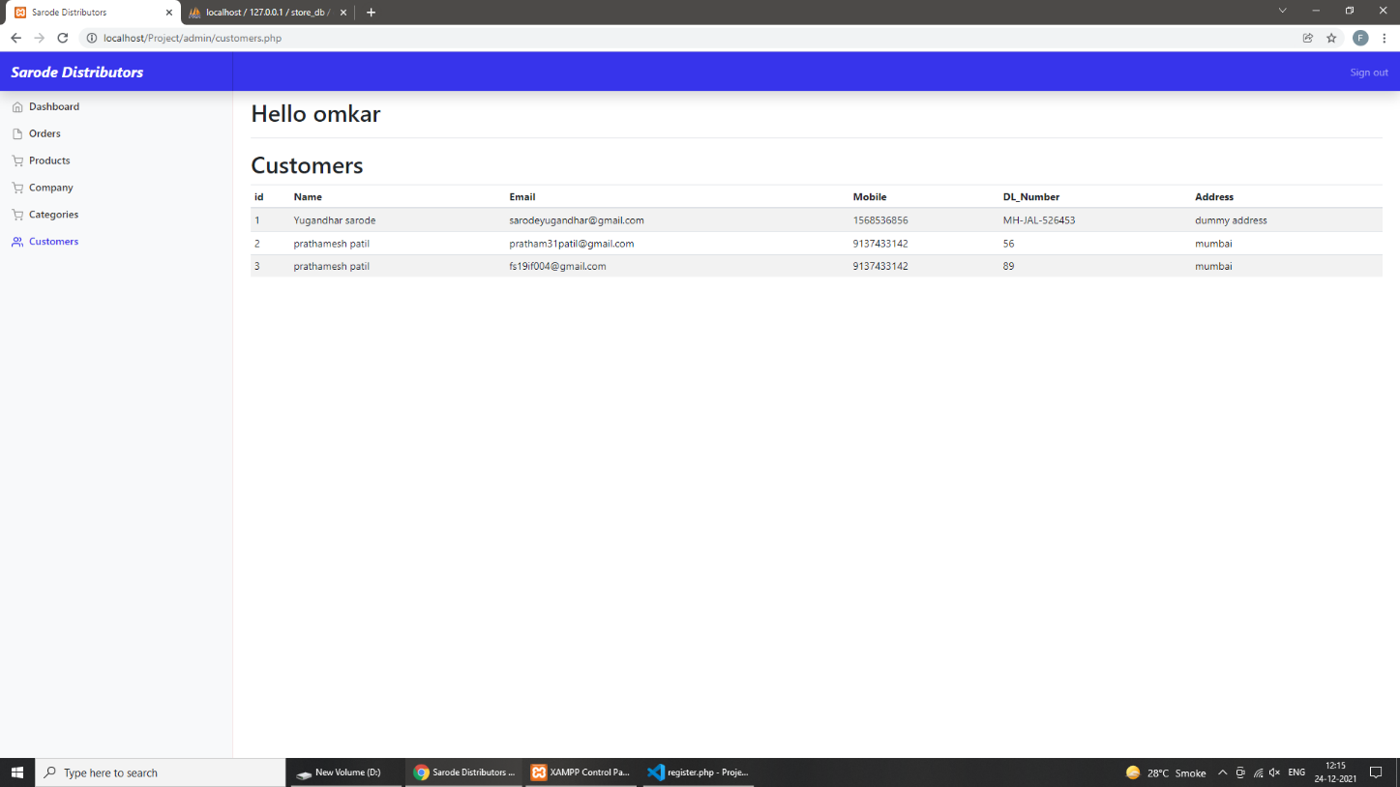
Customers Details

Slide 26
Future Plans:-
OTP verification can be added on both Admin and customer login.
Customer can easily search product in website.
Customer will receive an Invoice after booking the order with Proper GST and other Taxes included if any.

Slide 27
Conclusion:-
The project entitled “Order Management website for "Sarode Distributors” is developed using HTML,CSS and BOOTSTRAPas front end and PHP,JAVASCRIPT and MYSQL database in back end to computerised the process of online Ordering and selling of medicines.This project covers the basic features required.

Slide 28
References:-
https://getbootstrap.com/
https://www.phpmyadmin.net/
https://www.w3schools.com/
https://github.com/
https://fontawesome.com/
https://unsplash.com/

Slide 29
.......THANK YOU.......

